Slide 1
Graphs

Slide 2
Data Types & Dataset Types
Note: This is minimal, other data types may be present
Images from Munzner, Visualization Analysis and Design

Slide 3
Directed Acyclic Graphs (DAGs)
Depth 0
Rank 0
Depth 1
Rank 1
Rank 2
Depth 3
Rank 3
Tree
DAG

Slide 4
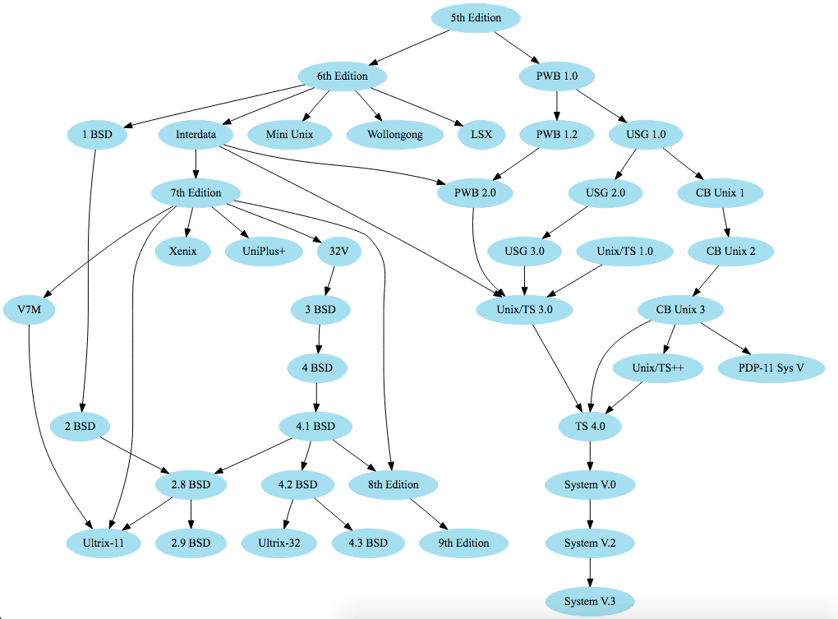
Unix Family c. 1986 – graphviz.org

Slide 5
Layered Graphs
Many graphs, such as DAGs exhibit a highly layered, ordered, or hierarchical structure.
As with the RT-trees, layout should preserve the ordering by encoding it with one spatial dimension
The Sugiyama family of layouts target these graphs
Rank 0
Rank 1
Rank 3
DAG

Slide 6
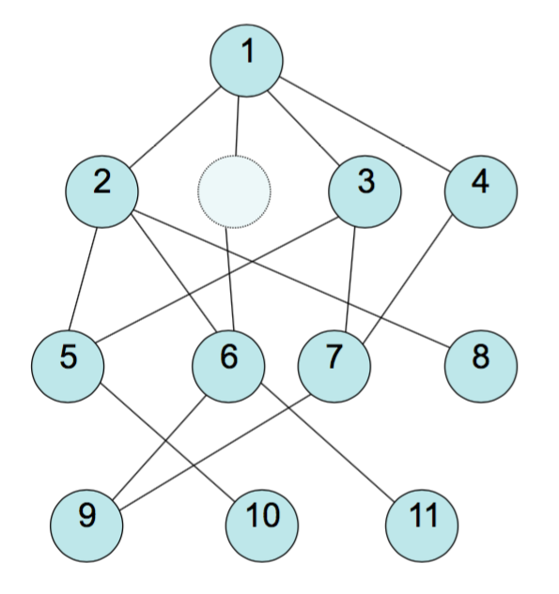
Sugiyama Layout – Step 1
Define an ordering:
Ranks (longest path from root)
May reverse some edges in this step
Domain-specific knowledge
“Best layering” (NP-hard)
Insert “dummy nodes” for long edges. These will be used for edge routing.
How many? Definition of “long”?
Adapted from Josh Levine & Miriah Meyer, slides

Slide 7
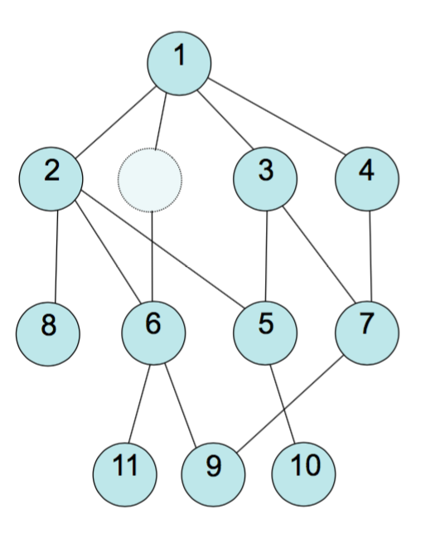
Sugiyama Layout – Step 2
Layer-by-layer, minimize edge crossings
NP-hard
Many heurstics
Many tuning parameters (e.g., how many passes?)
Adapted from Josh Levine & Miriah Meyer, slides

Slide 8
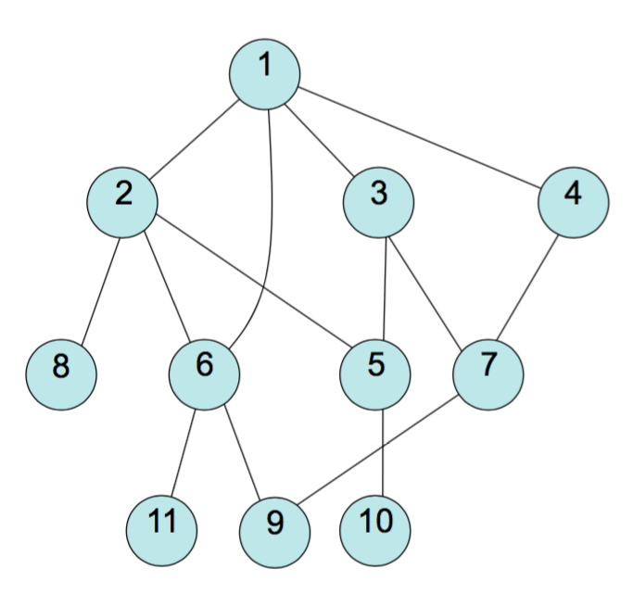
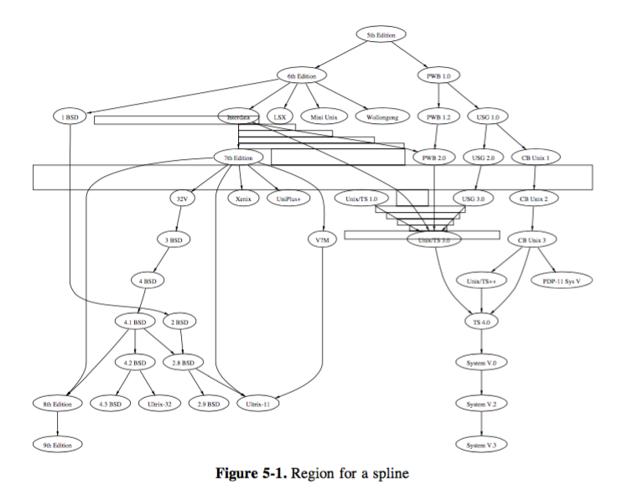
Sugiyama Layout – Step 3
Finalize x-coordinates for nodes.
Route edges.
Adapted from Josh Levine & Miriah Meyer, slides. Routing image from Gansner et al. 1993

Slide 9
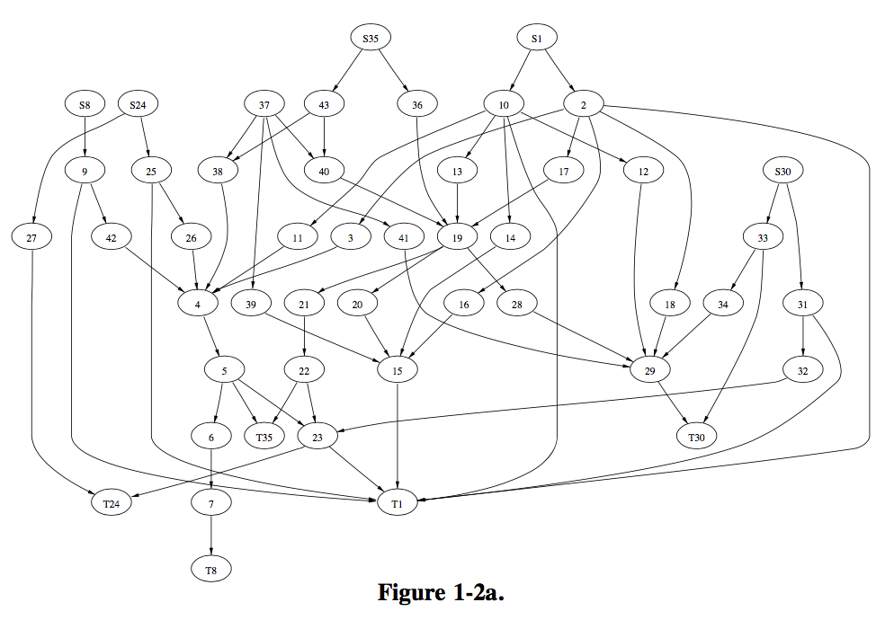
Image from Gansner et al. 1993

Slide 10
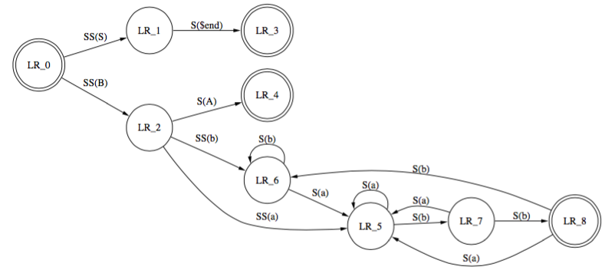
Sugiyama Layouts
Strengths:
Preserves flow
Relatively fast (up to ~5k nodes)
Issues:
Only suited for (near-)ordered graphs
Implementations:
dot (graphviz)
dagre
Adapted from Josh Levine & Miriah Meyer, slides & image from Gansner et al. 1993
Notes:
Edge crossing minimization is costly

Slide 11
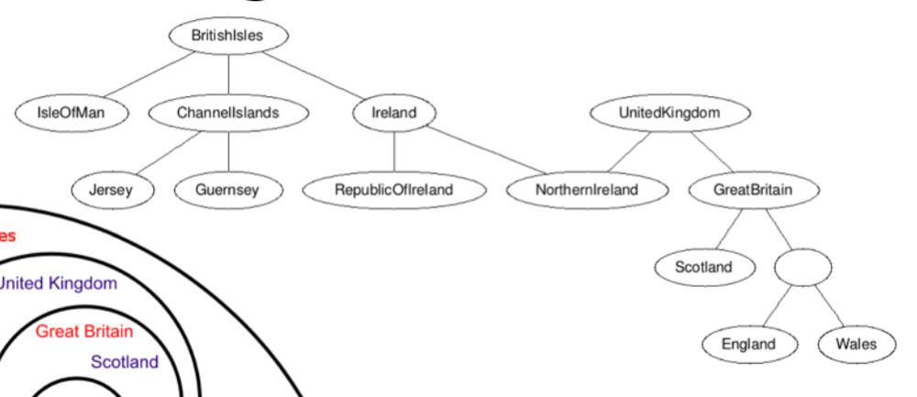
Drawing DAGs with Enclosure
From Stephen Kobourov, slides

Slide 12
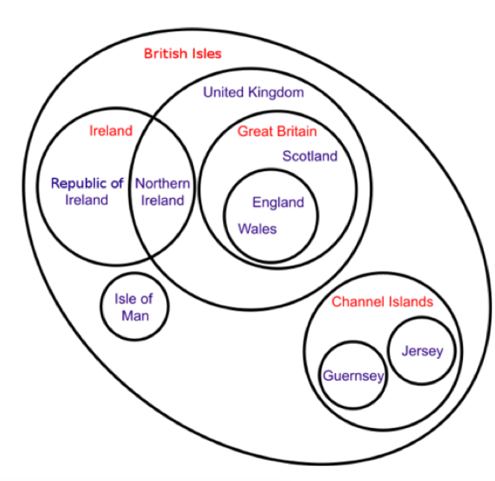
Drawing DAGs with Enclosure
From Stephen Kobourov, slides

Slide 13
Euler Diagrams
When also possible relationships are shown, they are Venn diagrams.
Algorithms can get complicated and produce odd shapes.
Hard to scale.
From Stephen Kobourov, slides

Slide 14
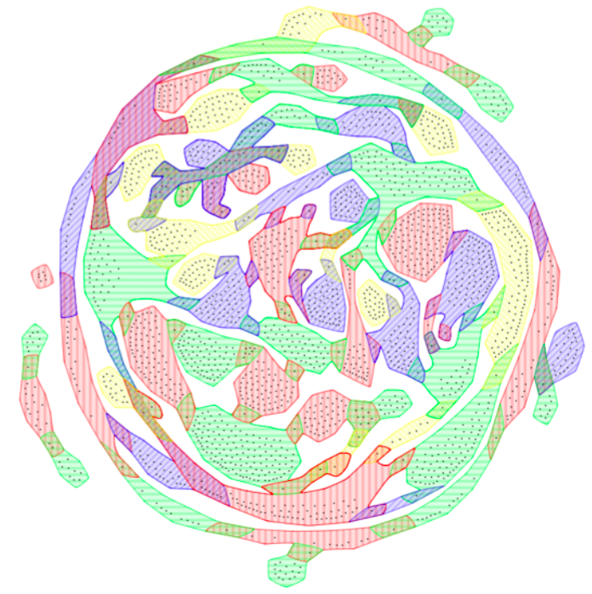
When also possible relationships are shown, they are Venn diagrams.
Algorithms can get complicated and produce odd shapes.
Hard to scale.
http://raweb.inria.fr/rapportsactivite/RA2009/gravite/3.png , via Stephen Kobourov, slides

Slide 15
General Graphs
What do we want our graph to show? What tasks?
Adjacency, connectivity, path following, clusters, shapes, structures, ordering
What qualities in graphs might help?
Known as graph drawing aesthetics / heuristics
Avoiding edge crossings
Avoiding edge bends
Keep edge lengths uniform
Avoid long edges
Cluster similar nodes
Maximize crossing angle
Avoiding node/edge overlap
Maximize global symmetry of graph
Maximize local symmetry of graph
Distribute nodes evenly
Maximize consistent flow direction
Emphasize clusters
See Bennett et al. 2007, The Aesthetics of Graph Drawing
Notes:
What are some issues with these heuristics – well for one they conflict with each other

Slide 16
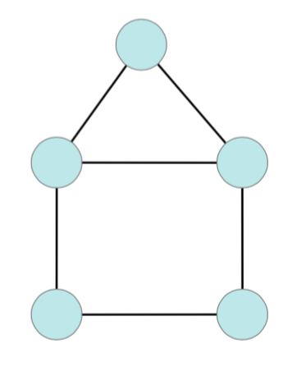
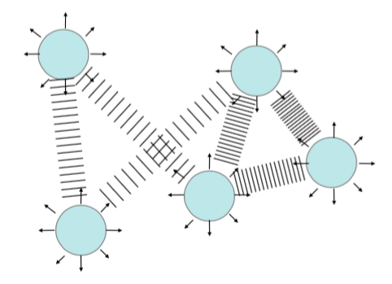
Force-Directed Layouts
Family of layouts that model graph as a physics problem:
Nodes as repulsive particles
Edges as springs
Adapted from Josh Levine & Miriah Meyer, slides
Notes:
Why do we think this works? What aesthetics does it help with?

Slide 17
Force-Directed Layout, Sketch
Repulsion: f_{R}(d) = C_{R} * m₁ * m₂ / d²
m₁ , m₂ are node masses or charge
d is distance between nodes
Attraction: f_{A}(d) = C_{A} * (d – L)
L is the rest length of the spring (applying Hooke’s law)
Total Force:
Σ_{y=neighbors(x)} f_{A}(||x’ – y’||) * (x’ – y’) – f_{R}(||x’ – y’||) * (x’ – y’)
Adapted from Josh Levine & Miriah Meyer, slides

Slide 18
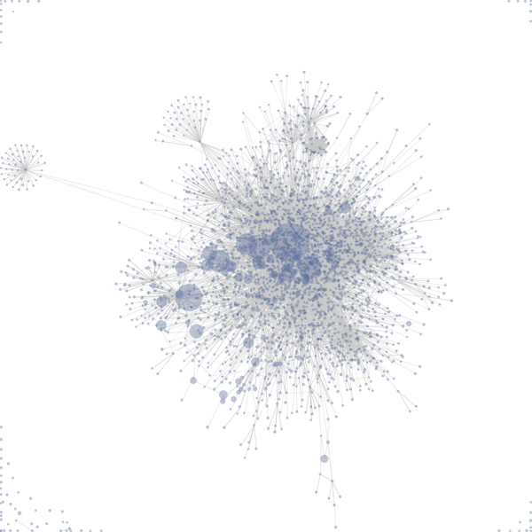
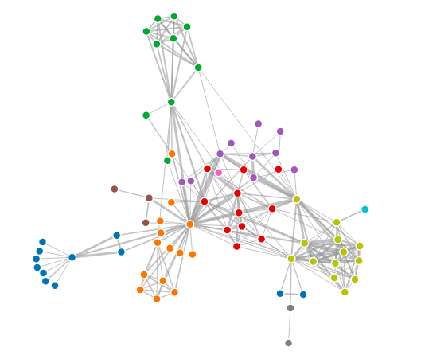
https://en.wikipedia.org/wiki/File:Visualization_of_wiki_structure_using_prefuse_visualization_package.png
https://beta.observablehq.com/@mbostock/d3-force-directed-graph
Notes:
Note how the disconnected nodes are getting pushed to the corners

Slide 19
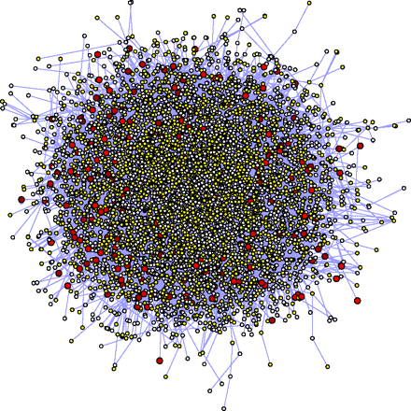
Force-Directed Layouts
Strengths:
Flexible
Can tweak / add forces
Can be fast when optimized
Not hard to implement
Issues:
Few structures preserved
Not stable
Force calculation is O(n²)
Can use quadtree/k-d tree for O(n log n)
Can sparsify first
Prone to local minima
Simulated annealing can help
Adapted from Josh Levine & Miriah Meyer, slides, Image from http://www.pnas.org/content/104/51/20274/F1

Slide 20
What can we do in the face of increasing graph size and complexity?
Derive New Data — Match task, easier to understand
Reduce / Aggregate Data — Summarize to fewer items
Change View of Data Over Time — Interaction
Facet / Partition Data — Show a subset
Embed Data — Show a subset in context of a summary
Incorporate More Information in the Layout
Where have we already seen this?
Notes:
Another option: avoid showing it as a graph… does the graph really support the tasks you need?

Slide 21
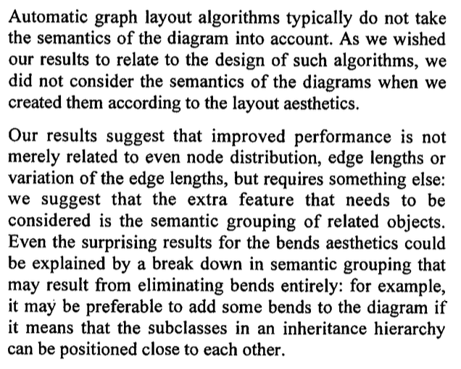
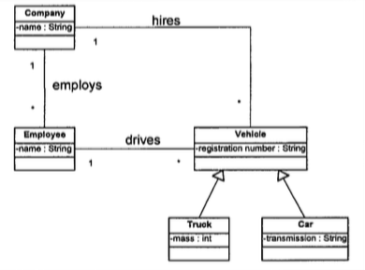
Domain-specific layout
Image/text from Purchase et al. Graph drawing aesthetics and the comprehension of UML class diagrams: an empirical study, 2002

Slide 22
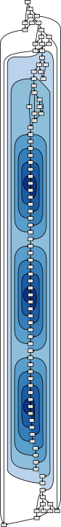
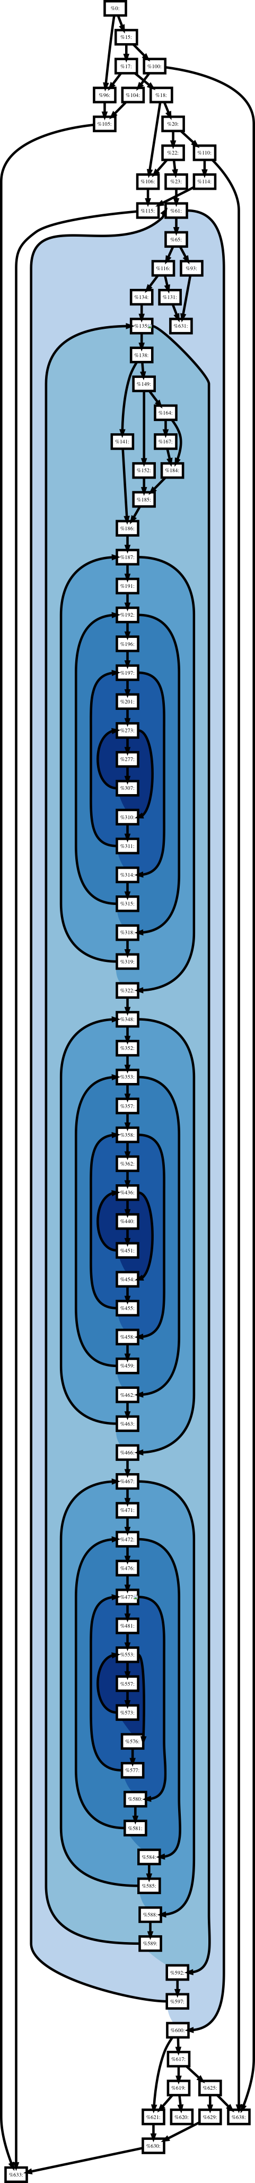
Images from Devkota & Isaacs 2018

Slide 23
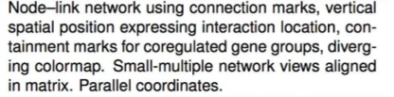
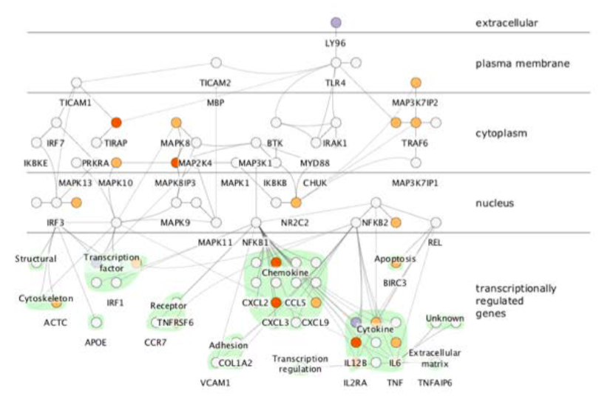
Attribute-driven Layout
Cerebral (Barsky 2008) via Munzner, Visualization Analysis and Design

Slide 24

Notes:
Geography is the attribute here

Slide 25
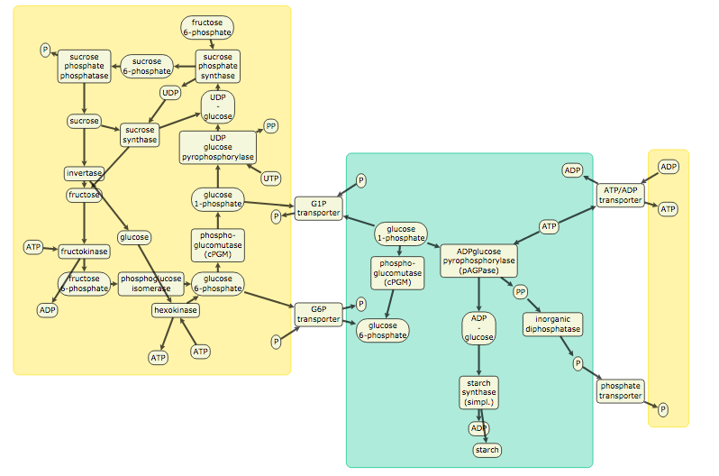
Constraint-Based Approaches
Uses the physics-based approach (energy minimization, stress majorization), but adds to the objective node-level (and sometimes edge-level) constraints for more flexibility in incorporating domain knowledge.
Single constraint:
WebCola, https://ialab.it.monash.edu/webcola/examples/SucroseBreakdown.html

Slide 26
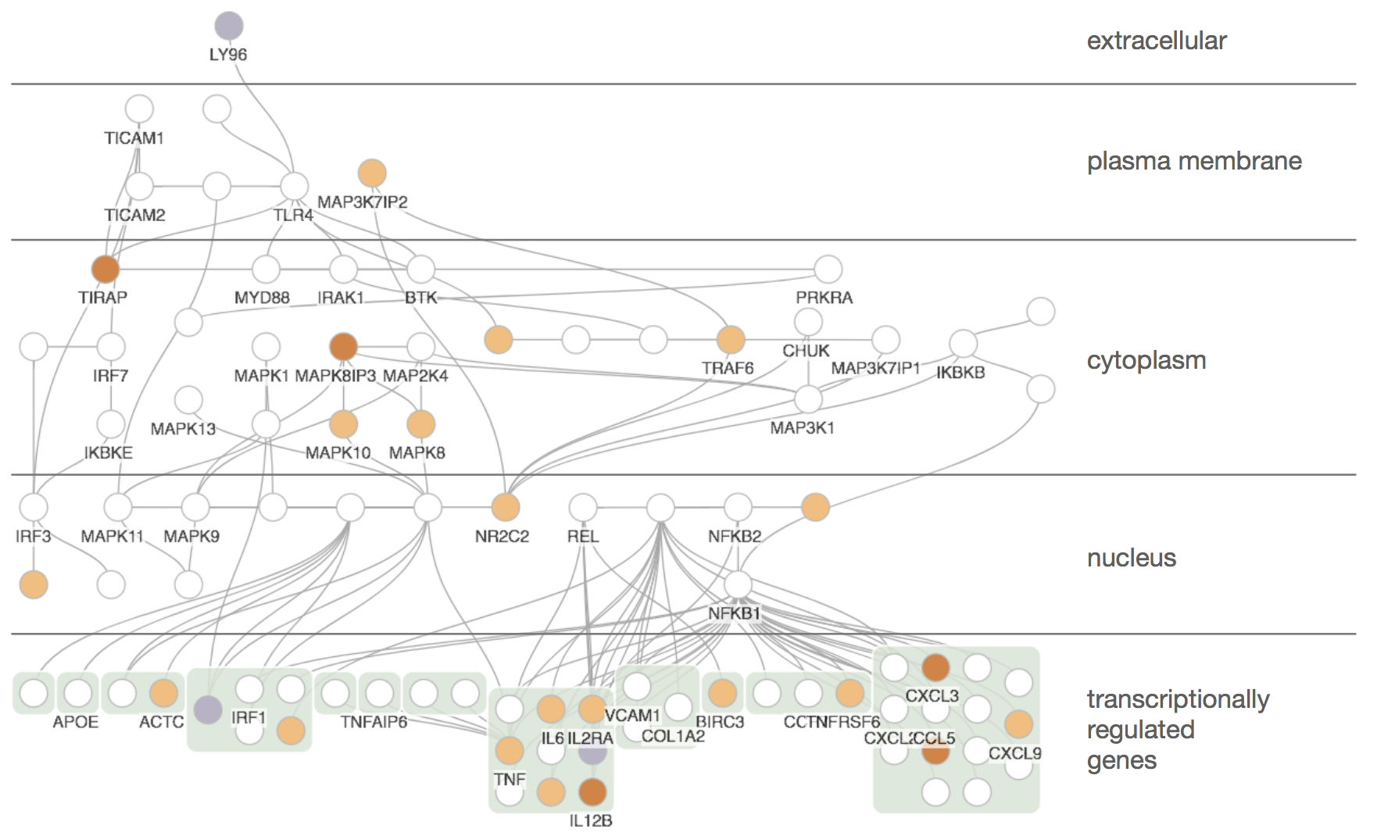
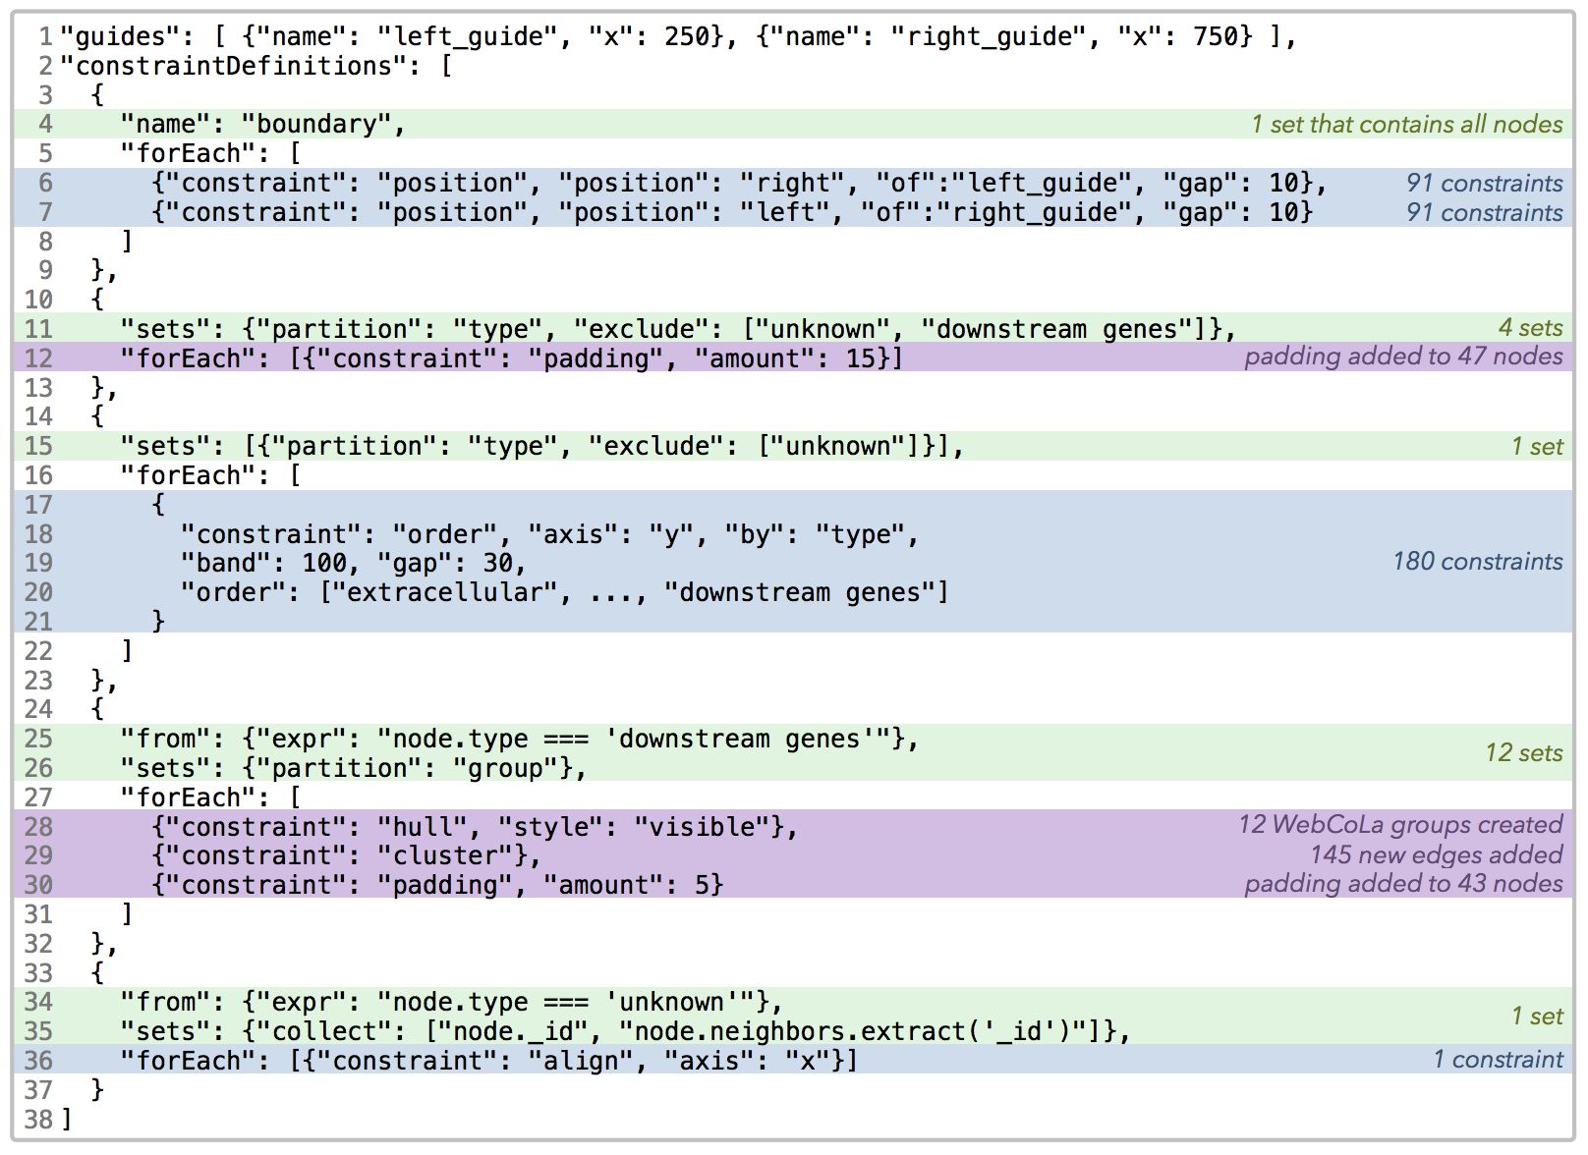
Constraint-Based Approaches
Hoffswell et al., 2018, SetCola

Slide 27
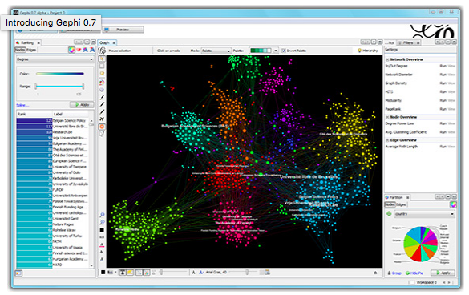
Libraries & Platforms with force-directed options
Libraries
GraphViz
d3js
cytoscape.js
cola.js
OGDF
Platforms/Tools
Gephi
Tulip

Slide 28
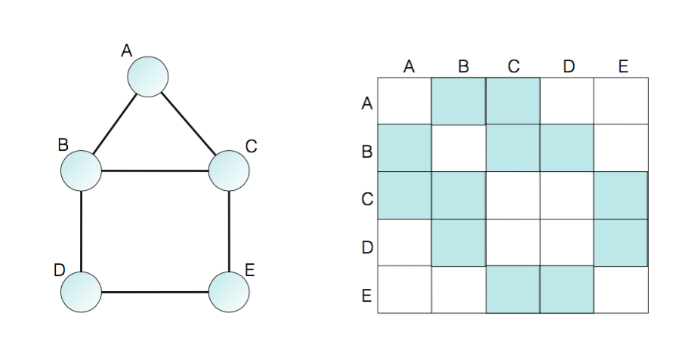
Representing Graphs with Adjacency Matrices
Adapted from Josh Levine & Miriah Meyer, slides

Slide 29
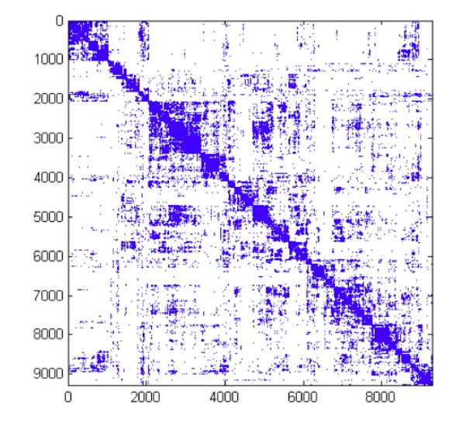
Representing Graphs with Adjacency Matrices
Strengths:
Dense representation (?)
Removes clutter for dense graphs
Cliques/clusters apparent if well-ordered
Issues:
Abstract
Hard to follow links
Adapted from Josh Levine & Miriah Meyer, slides

Slide 30
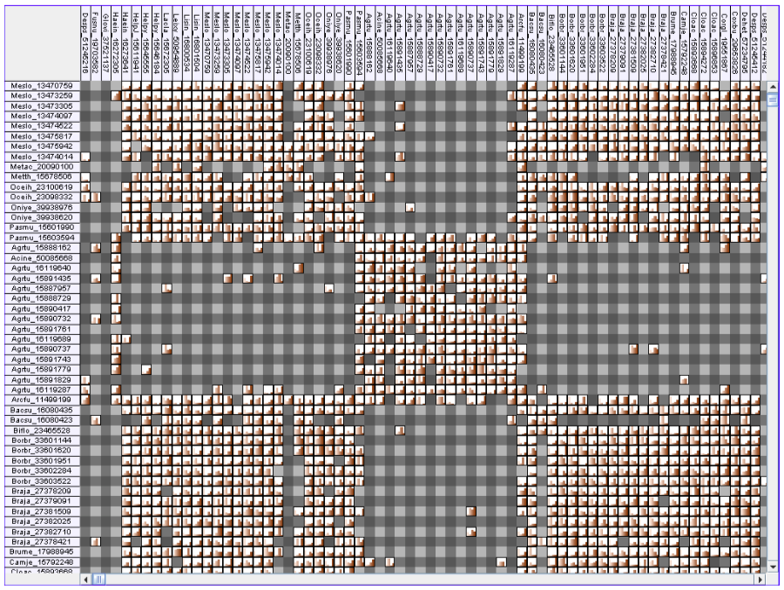
Elmqvist et al. 2008, ZAME

Slide 31
Task Taxonomies – Lee et al.
Task Abstractions & Taxonomies may exist for specific data types. Lee et al. contributed one for network data:
Topology-based
Adjacency – are two items directly connected?
Accessibility – are two items connected directly or indirectly?
Common connections – between two items, what are they both connected to?
Connectivity – shortest path, clusters, bridges
Attribute-based
Find set of nodes or links with some attribute value
Find extremum of attribute values on nodes or links
Browsing
Follow path
Return to previously visited node
Overview
Notes:
Derived from literature review

Slide 32
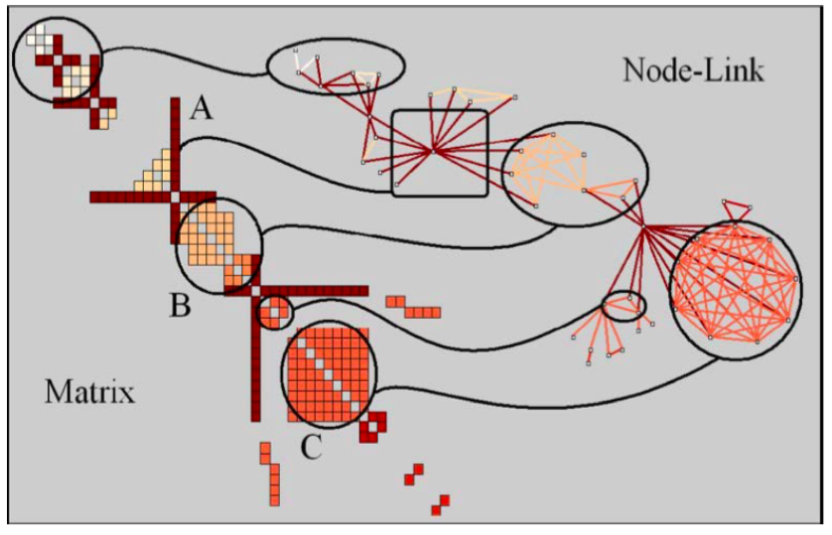
Patterns in Adjacency Matrices
Henry et al 2006

Slide 33
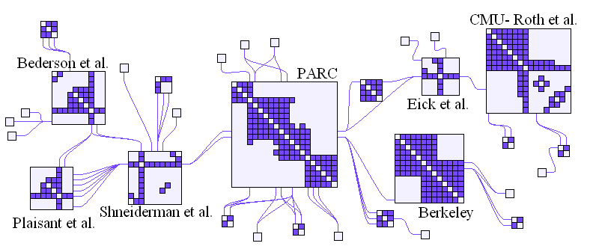
NodeTrix: Hybrid Visualization
Henry et al 2007

Slide 34
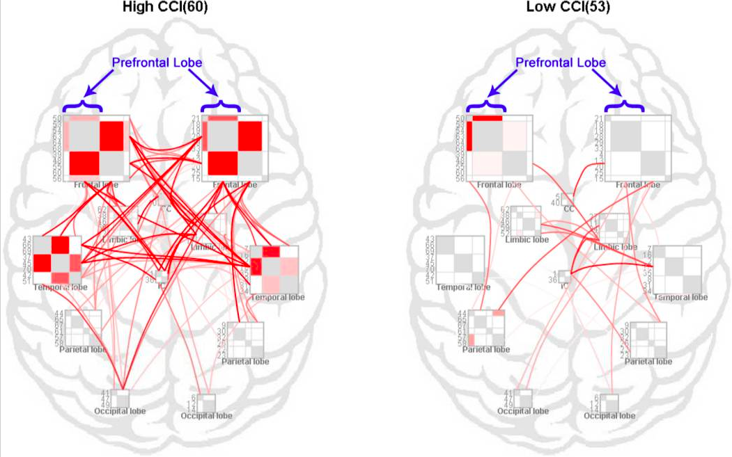
Yang et al. 2017, Blockwise Human Brain Network Visual Comparison Using NodeTrix Representation

Slide 35
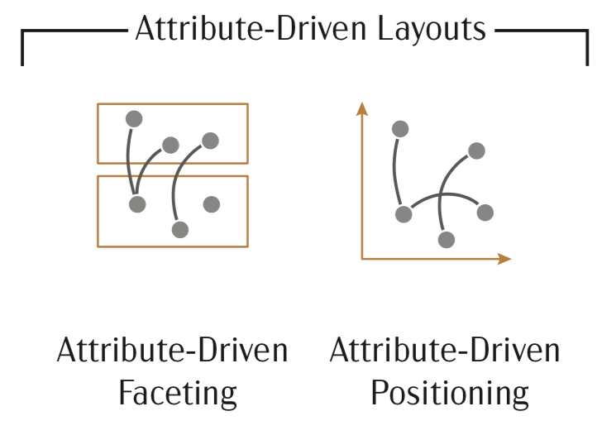
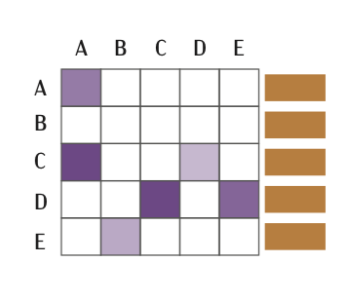
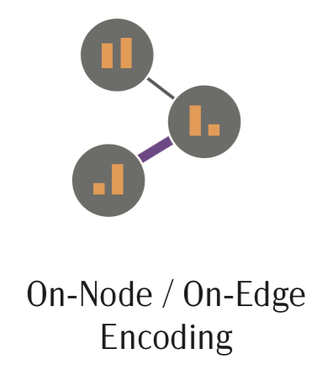
Some Options for Encoding Graphs with Attributes
Encode attribute directly on node
Attribute-driven layouts
Multiview techniques
Data reduction strategies (aggregation, filtering, derivation)
Images from Tamara Munzner, Visualization Analysis and Design and Nobre et al. STAR on Multivariate Networks (2019)

Slide 36
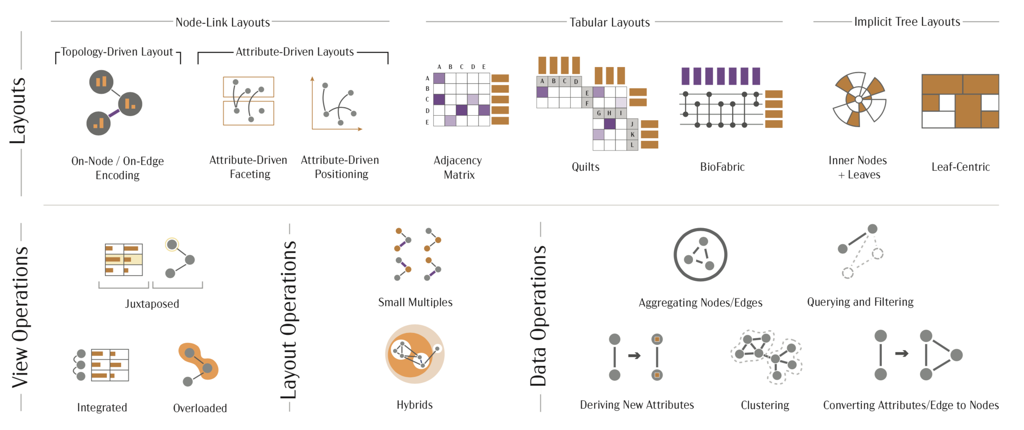
Images Nobre et al. STAR on Multivariate Networks (2019)
Notes:
How do some of these techniques relate to others we have already discussed? In particular, the mutli-view techniques

Slide 37
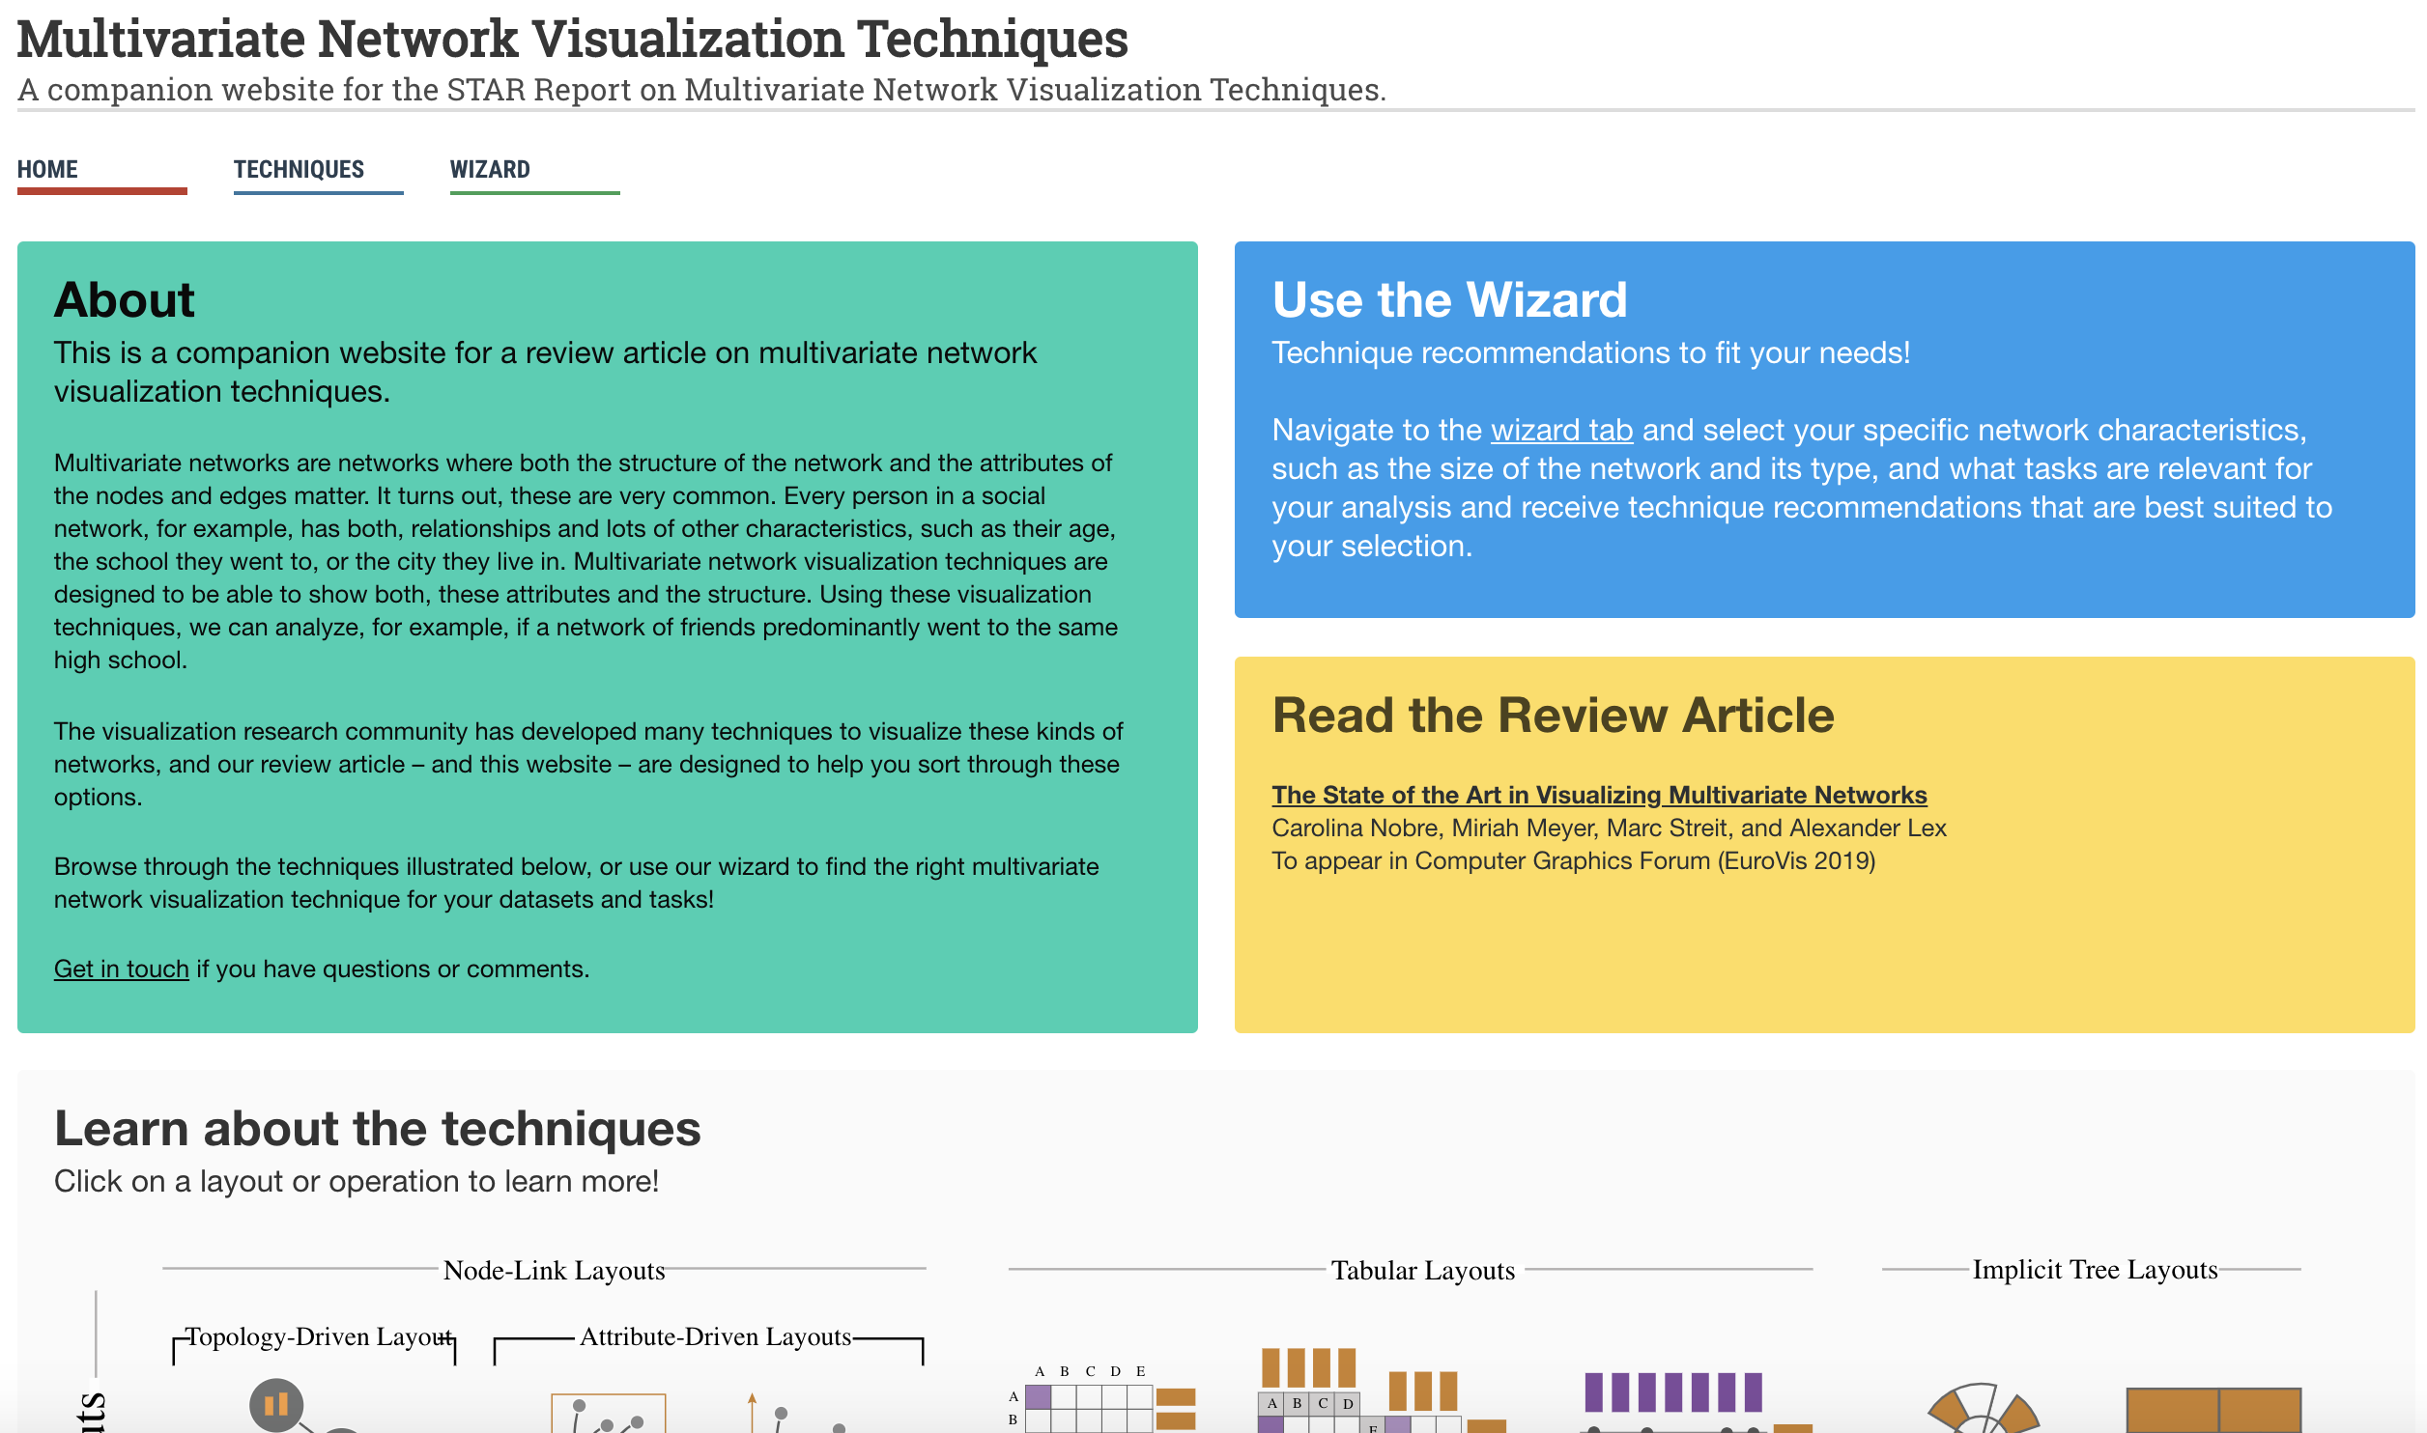
Notes:
https://vdl.sci.utah.edu/mvnv/

Slide 38
General Starting Points on Graphs
Trees
Indention good when fits on screen
Node-link & layered good for most tasks but require space
Enclosure diagrams good for size comparison tasks but not structure
Graphs
Node-link diagrams are easier to understand, better for path-tasks
Domain-specific layouts can go a long way
Adjacency matrices scale better, good for clusters and dense graphs

Slide 39
